Slide 1
EEL 4914 Senior Design Project Presentation Title: Car Insight Submitted by: Johnny Li Advisory Engineer: Zane P Zudans

Slide 2
Introduction
Build a battery powered autonomous robotic car.
Platform for testing proximity detection and collision avoidance.
Use AI to solve a maze and then reverse to use the most optimal path back out.
Problem: To ensure passenger and public safety in autonomous cars.
What is out there already?
Integrated into many cars: Tesla, Waymo, and GM Cruise.
Vehicle sensors: Camera, Radar, and Lidar.
Ultrasonic sensors, traditionally associated with parking.
LED, Speaker, Digital features (LCD, Timer)

Slide 3
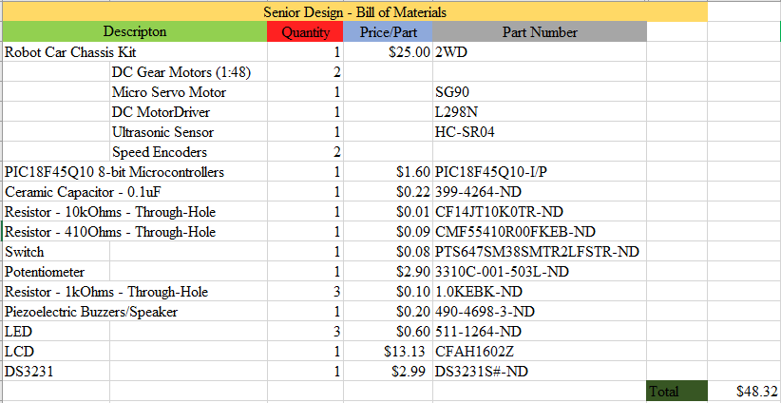
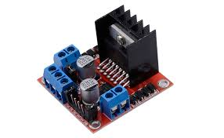
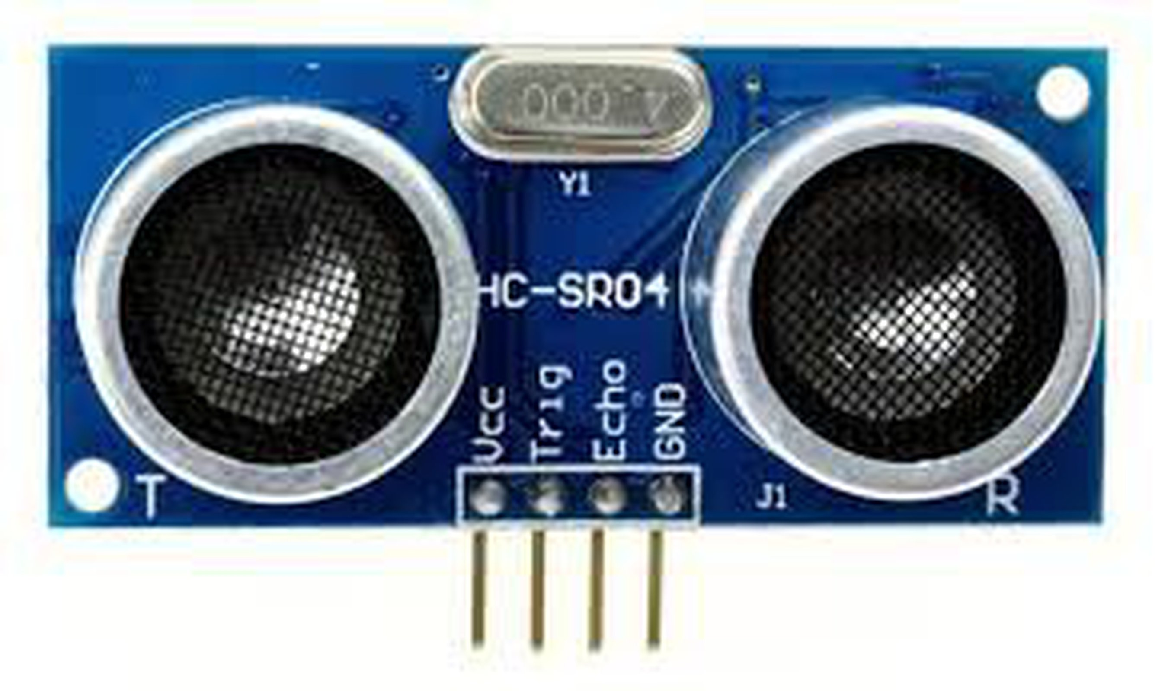
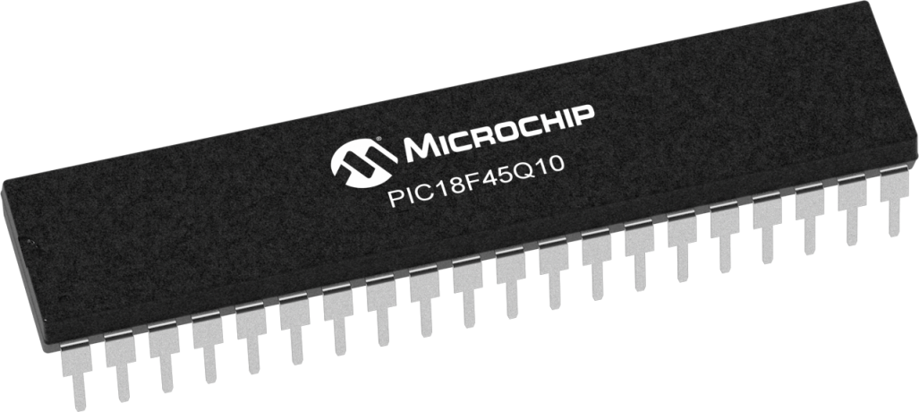
Project Description + Hardware
Ultrasonic object detection
Mount on servo to provide 180°
Battery Power at ~5V
LCD screen
LEDs and speaker
Gear motor to control movement
PIC18F45Q10 Microcontroller:
2 x I2C/SPI, 8-bit timer, PWM
Dual channel H bridge motor driver
HC-SR04
PIC18F45Q10

Slide 4
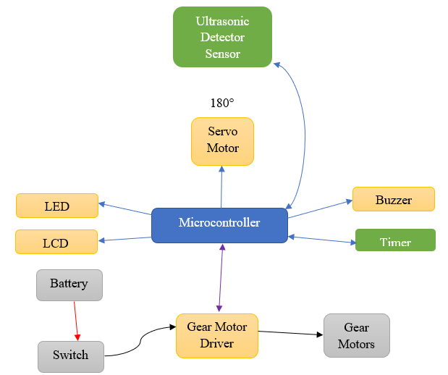
Project hardware block diagram

Slide 5
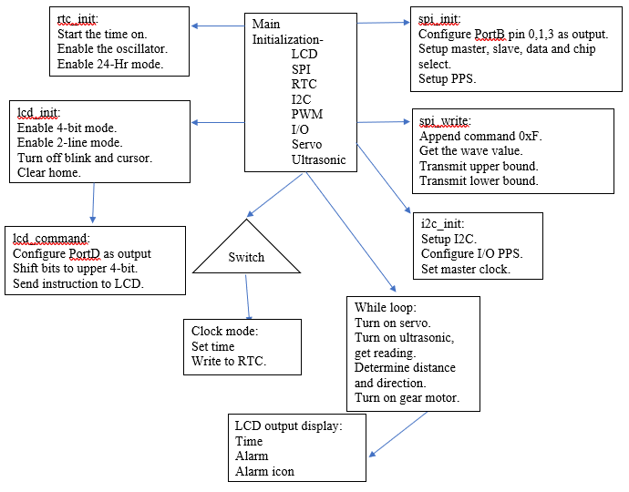
Project software flow chart + Software
Using MPLAB, write code in C.
Interfacing the ultrasonic detector to the microcontroller.
The microcontroller then calculates the distance.
The motor will be turned on for some time determined by AI.
Reached the desired point or timeout to rescan forward.
If an obstacle is detected it will move to avoid it.
Path taken by the car will be recorded. AI will then optimize the path back out the maze.
The microprocessor will control warning signals, scan time, and LCD output.
Object detected:
Turn left or right based on which side has the greatest amount of room.
Continue based on AI decision.

Slide 6
Gantt Chart

